Slide 1
Operator Overloading
COS 1020 C++ Programming
AUBG COS Department
Based on chapter 11 – problem solving, abstraction and design using C++, Friedman & Koffman

Slide 2
Lecture Contents
11.2 Operator Overloading and Friends

Slide 3
Operator Overloading
More than one way to provide operator functions for class objects
  Pass second object to first object’s lessThan member function
  e1.lessThan(e2);
  Overloading existing operators, such as <, >, <<
  e1 < e2
  Use friend functions to implement the operation
  lessThan(e1,e2);

Slide 4
The this Keyword
The pointer this is a local variable that points at the current object of a class
Available in non-static member functions of a class
Does not need to be declared
Cannot be changed
*this is the current object and can be returned by a member function

Slide 5
The this Keyword (continued)
class Test {
public:
void print() {
cout << this->a;
}
void setA(int a) {
this->a = a;
// (*this).a = a;
}
private:
int a;
};

Slide 6
Special Functions Defaults
If no constructor is defined for a class, one that initializes the data members using language defaults is automatically generated
In C++, classes come with three other special functions, which have default behavior that can sometimes be accepted (and you will not need to define them explicitly):
  Destructor
  Copy constructor
  operator= (copy assignment operator)

Slide 7
Class Destructor
A class destructor is a member function, called whenever an object goes out of scope or is subject to a delete
Its role is to free resources that were allocated by the constructor or other methods during the object’s lifetime:
  Calling delete for any objects created with new
  Closing any open files, etc
The default destructor (if one is not implemented) simply applies the destructor to each data member

Slide 8
Copy Constructor
The copy constructor is a constructor which creates an object by initializing it to an object of the same class
It will be called in cases like:
IntCell B = C;
IntCell B(C);
IntCell B = foo();
  When an object is passed or returned by value (instead of by reference)
But not in this case (which invokes operator=):
  B = C;

Slide 9
Copy Constructor (continued)
By default, the copy constructor is a data member-by-member application of copy constructors
  For data members that are primitive types (int, double, or pointers), simple assignment is done
  For data members that are class objects, the copy constructor for each data member’s class is applied to that data member

Slide 10
operator=
The copy assignment operator – operator=, is used to copy existing objects
It is called when assignment (=) is applied to two already constructed objects:
  lhs = rhs;
Intended to copy the state of one existing object (rhs) into another existing object (lhs)
By default the operator= is implemented by applying operator= to each data member in the class

Slide 11
Special Functions Example
IntCell::~IntCell() {}
IntCell::IntCell(const IntCell & rhs)
: storedValue(rhs.storedValue) {}
// same as this:
IntCell::IntCell(const IntCell & rhs) {
storedValue = rhs.storedValue;
}

Slide 12
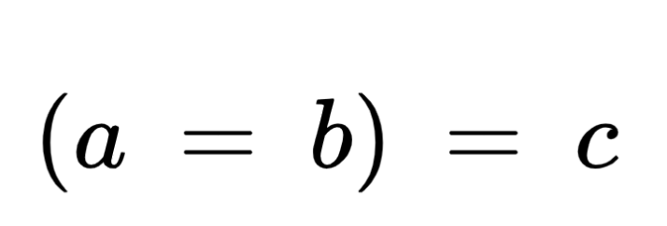
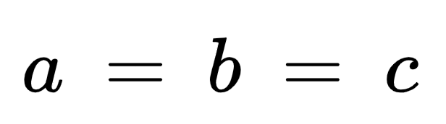
Special Functions Example (continued)
const IntCell & IntCell::operator=(const IntCell & rhs) {
if (this != &rhs) // alias test: a = a; is meaningless!
storedValue = rhs.storedValue;
return *this;
}
Will not work! Will work!

Slide 13
When the Defaults Do Not Work
The most common situations where the defaults would not work is when a data member is a pointer
Pointer members might cause problems like:
  Shallow copies – instead of allocating new memory and assigning the correct value to it, the defaults will perform pointer assignment only, which cause the two pointer members to point to the same memory location
  Memory leak – any memory allocated with new needs to be reclaimed with delete

Slide 14
Rational ADT Design
Data slots:
  int numer (numerator)
  int denom (denominator) denom != 0
Operations:
Constructors: Rational(), Rational(int), Rational(int, int), Rational(Rational&)
Accessors: double toDouble(), <<
Mutators: =, +=, -=, *=, /=, >>
Operators: +, -, *, /, unary -, ++, --, <, <=, >, >=, ==, !=
Axioms:
  The GCD of numer and denom should be 1
  If negative, the numer holds the minus sign
  Enforced by the private function normalize()

Slide 15
Rational Class Interface (Part 1 of 3)
class Rational {
public:
Rational(int numerator = 0); // Rаtional r; Rаtional r1(2);
Rational(int numerator, int denominator);
Rational(const Rational &rhs);
~Rational();
// assignment operators
const Rational& operator=(const Rational & rhs); // lhs = rhs
const Rational& operator+=(const Rational & rhs); // lhs += rhs
const Rational& operator-=(const Rational & rhs); // lhs -= rhs
const Rational& operator*=(const Rational & rhs); // lhs *= rhs
const Rational& operator/=(const Rational & rhs); // lhs /= rhs
// binary arithmetic operators
Rational operator+(const Rational & rhs) const; // Rаtional a = lhs + rhs
Rational operator-(const Rational & rhs) const; // Rаtional a = lhs - rhs
Rational operator*(const Rational & rhs) const; // Rаtional a = lhs * rhs
Rational operator/(const Rational & rhs) const; // Rаtional a = lhs / rhs

Slide 16
Rational Class Interface (Part 2 of 3)
// relational and equality operators
bool operator<(const Rational & rhs) const; // if (lhs < rhs) -> true or false
bool operator<=(const Rational & rhs) const; // if (lhs <= rhs)
bool operator>(const Rational & rhs) const; // if (lhs > rhs)
bool operator>=(const Rational & rhs) const; // if (lhs >= rhs)
bool operator==(const Rational & rhs) const; // if (lhs == rhs)
bool operator!=(const Rational & rhs) const; // if (lhs != rhs)
// unary operators
Rational operator-() const; // -lhs
const Rational& operator++(); // ++lhs
Rational operator++(int); // lhs++
const Rational& operator--(); // --lhs
Rational operator--(int); // lhs--

Slide 17
Rational Class Interface (Part 3 of 3)
// IO friends
// cout << lhs << rhs << endl;
// cin >> lhs >> rhs;
friend ostream& operator<<(ostream & out, const Rational & value);
friend istream& operator>>(istream & in, Rational & value);
// member functions
double toDouble();
private:
int numer, denom;
// ensures lowest form
void normalize();
};

Slide 18
Rational Class Implementation – Constructors and Destructor
Rational::Rational(int numerator)
: numer(numerator), denom(1) {}
Rational::Rational(int numer, int denom)
: numer(numer), denom(denom) {
normalize();
}
Rational::Rational(const Rational & rhs)
: numer(rhs.numer), denom(rhs.denom) {}
Rational::~Rational() {}

Slide 19
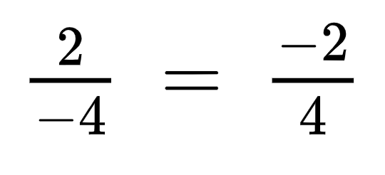
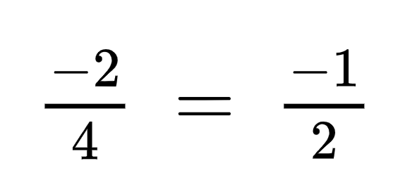
Rational Class Implementation –
Private Members
double Rational::toDouble() {
return (double) numer / denom;
}
void Rational::normalize() {
assert(denom != 0);
if (denom < 0) { // fix signs
denom = -denom;
numer = -numer;
}
int d = gcd(numer, denom);
numer /= d;
denom /= d;
}

Slide 20
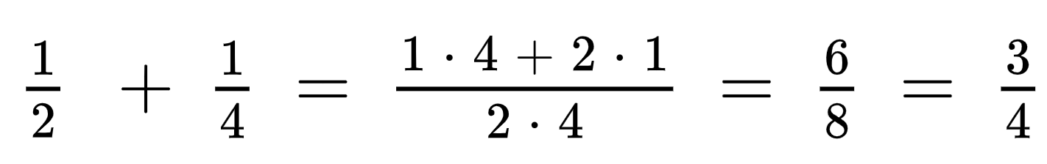
Rational Class Implementation – Assignment Operators (partial)
const Rational & Rational::operator=(const Rational & rhs) {
if (this != &rhs) {
numer = rhs.numer;
denom = rhs.denom;
}
return *this;
}
const Rational & Rational::operator+=(const Rational & rhs) {
numer = numer * rhs.denom + rhs.numer * denom;
denom = denom * rhs.denom;
normalize();
return *this;
}

Slide 21
Rational Class Implementation –
Arithmetic and Relational Operators (partial)
Rational Rational::operator+(const Rational & rhs) const
{
Rational answer(*this);
answer += rhs; // we already implemented operator+= so we could use it
return answer;
}
bool Rational::operator==(const Rational & rhs) const
{
return numer * rhs.denom == denom * rhs.numer;
}

Slide 22
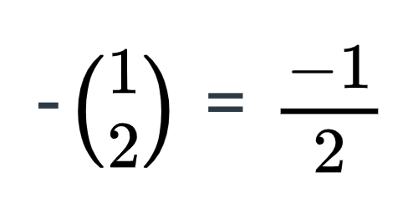
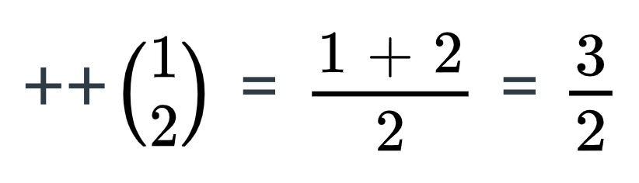
Rational Class Implementation –
Unary Operators (partial)
Rational Rational::operator-() const
{
return Rational(-numer, denom);
}
const Rational & Rational::operator++() // prefix form (++r)
{
numer += denom;
return *this;
}
Rational Rational::operator++(int) // postfix form (r++),
{ // int is not formal parameter, so no name
Rational tmp = *this;
numer += denom;
return tmp;
}

Slide 23
Rational Class Implementation –
Input Output and Friends (Part 1 of 2)
istream & operator>>(istream & in, Rational & value) { // cin >> obj1 >> obj2;
in >> value.numer;
value.denom = 1;
char c;
in >> c;
if (!in.eof()) {
if (c == '/') {
in >> value.denom;
value.normalize();
}
else
in.putback(c);
}
return in;
}

Slide 24
Rational Class Implementation –
Input Output and Friends (Part 2 of 2)
ostream & operator<<(ostream & out, const Rational & value) {
out << value.numer << "/" << value.denom;
return out;
}
When the I/O operator functions are called, Rational is not the controlling object
To allow access to its private members to a non-member function, the Rational class declares these two as friends:
friend ostream& operator<<(ostream & out, const Rational & value);
friend istream& operator>>(istream & in, Rational & value);

Slide 25
Questions?
Q & A

